Slide 1

W207 Applied Machine Learning Richard Huntsinger Division of Data Science & Information University of California, Berkeley Fall 2019

Slide 2
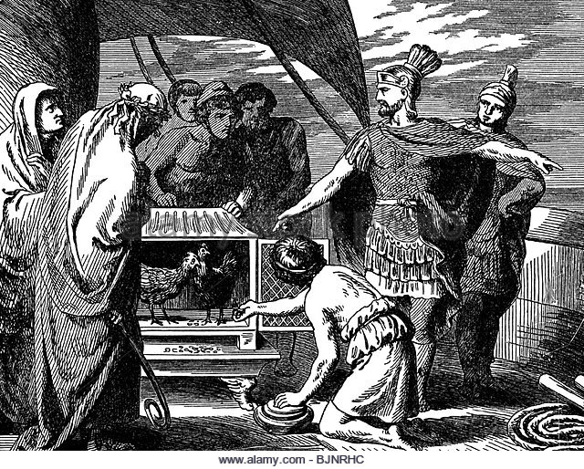
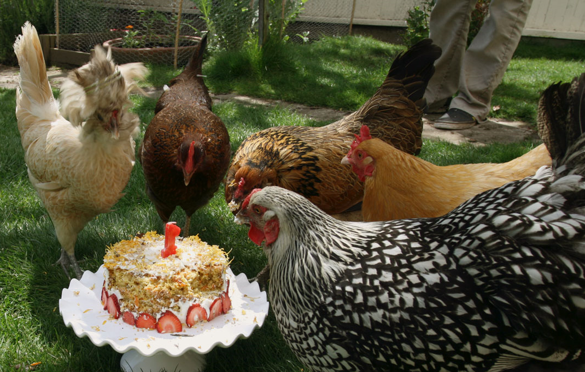
Roman Chickens
Publius Claudius Pulcher & the Battle of Drepana in 249 BC
Model: ŷ = 0 + 1x
"Bibant, quoniam esse nolunt.”
x = 1 means chickens ate cake
x = 0 means chickens did not eat cake
y = 1 means Romans won battle
y = 0 means Romans lost battle

Slide 3

Lending Tree

Slide 4
Class Administration
“When I hear, I forget. When I see, I remember. When I do, I understand.”
About participation
Syllabus
Syllabus addendum
Calendar
Anaconda 2019.07, Jupyter Notebook 6.0.0, .jupyter/custom/custom.css
Python 3.7.3, numpy 1.16.4, matplotlib 3.1.0, sklearn 0.21.2
ISVC
Slack #w207
Slack #w207-5-fall-2019
Github MIDS-W207/coursework

Slide 5
Reading
“The Unreasonable Effectiveness of Data” by Halevy, Norvig, Pereira
Rules from experts vs. Rules from data
Problems:
representation, model encoding, inference/prediction
Authors’ advice:
choose representation for unsupervised learning
choose non-parametric model
no new variables

Slide 6
Concepts
Artificial Intelligence
Data Analytics
Machine Learning
Deep Learning
Supervised Machine Learning
Unsupervised Machine Learning
Model, Build a Model, Fit a Model
Classification, Classifier
Regression, Regressor
Cluster Analysis
Evaluation
In-Sample Evaluation
Holdout, Out-of-Sample Evaluation
Cross-Validation
Confusion Matrix
Loss, Cost, Error, Metric
Model Optimization, Tuning
Bias/Variance Tradeoff
Overfitting
Regularization
Naïve Bayes
Support Vector Machine
Neural Network, Perceptron
Logistic Regression
Decision Tree
Random Forest
k-Nearest Neighbor
Linear Regression
Hyper-Parameters
Ensemble Meta-Methods
Hierarchical Agglomeration
k-Means
Gaussian Mixture Model by Expectation-Maximization
Data Representation, Feature Engineering
Dimensionality Reduction
Principal Component Analysis

Slide 7
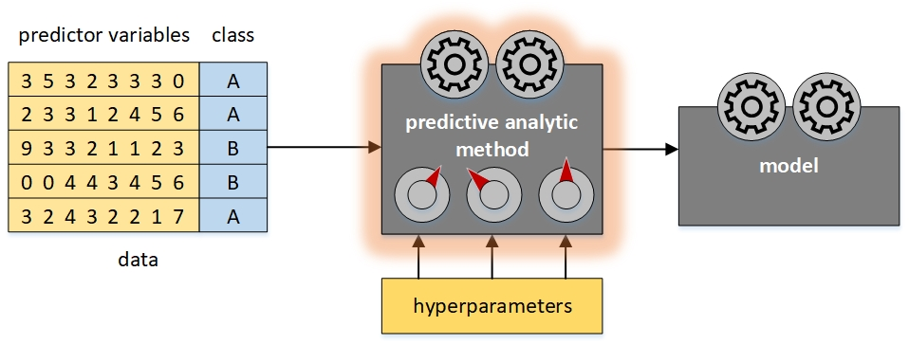
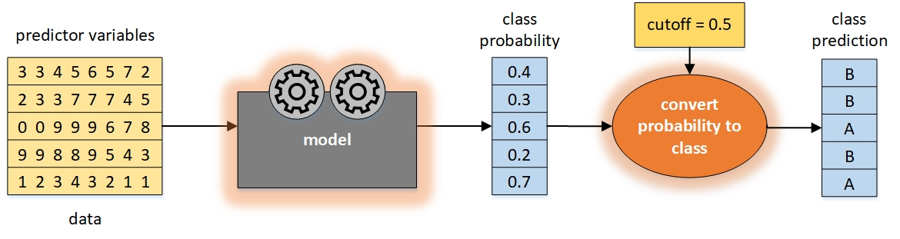
Classification
Train
Predict

Slide 8
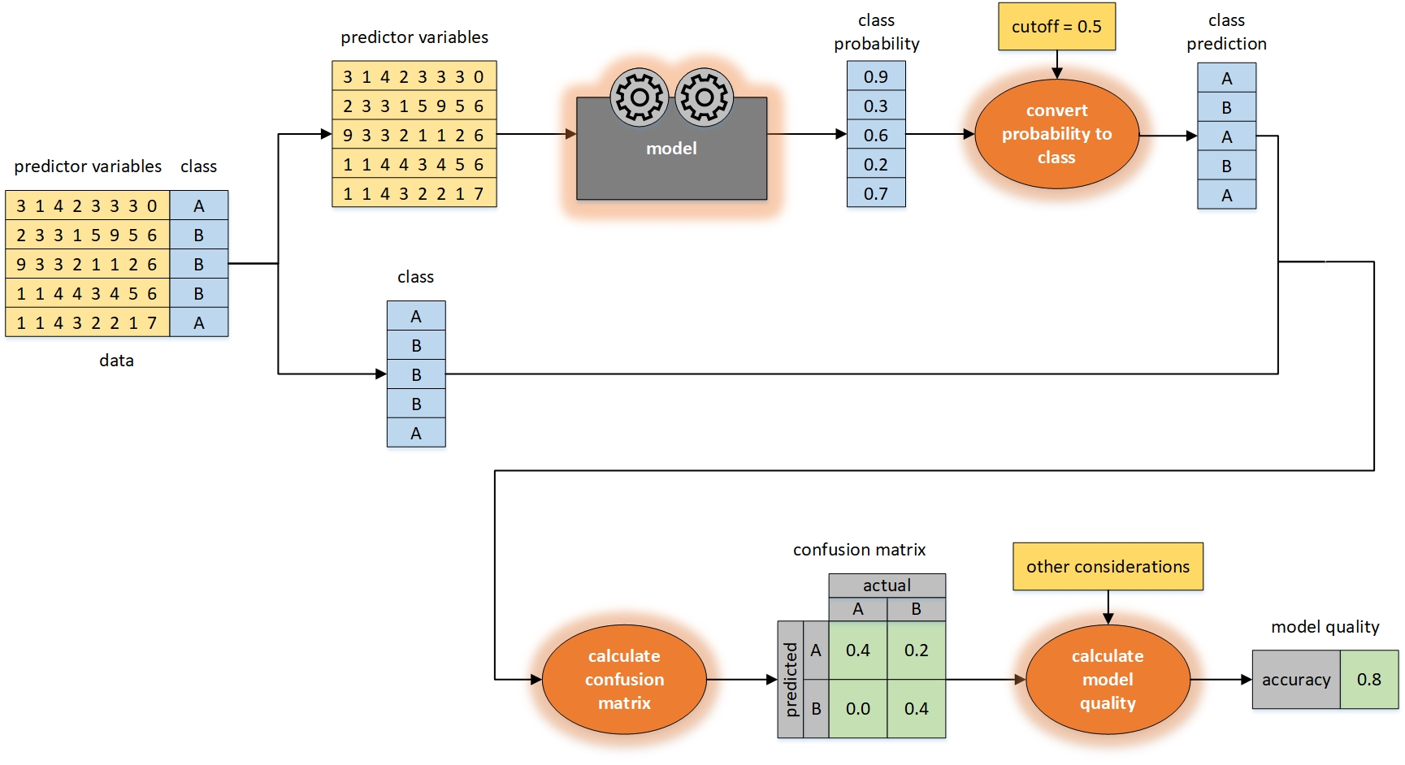
Classification
Evaluate

Slide 9
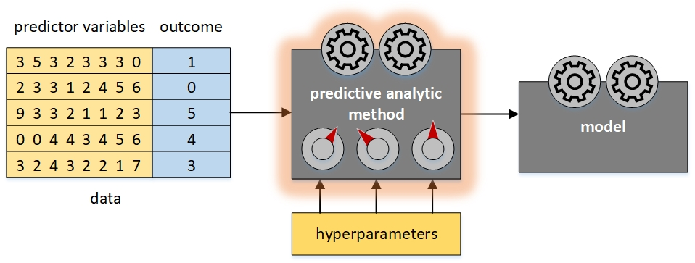
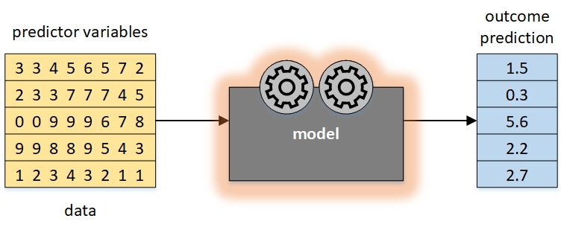
Regression
Train
Predict

Slide 10
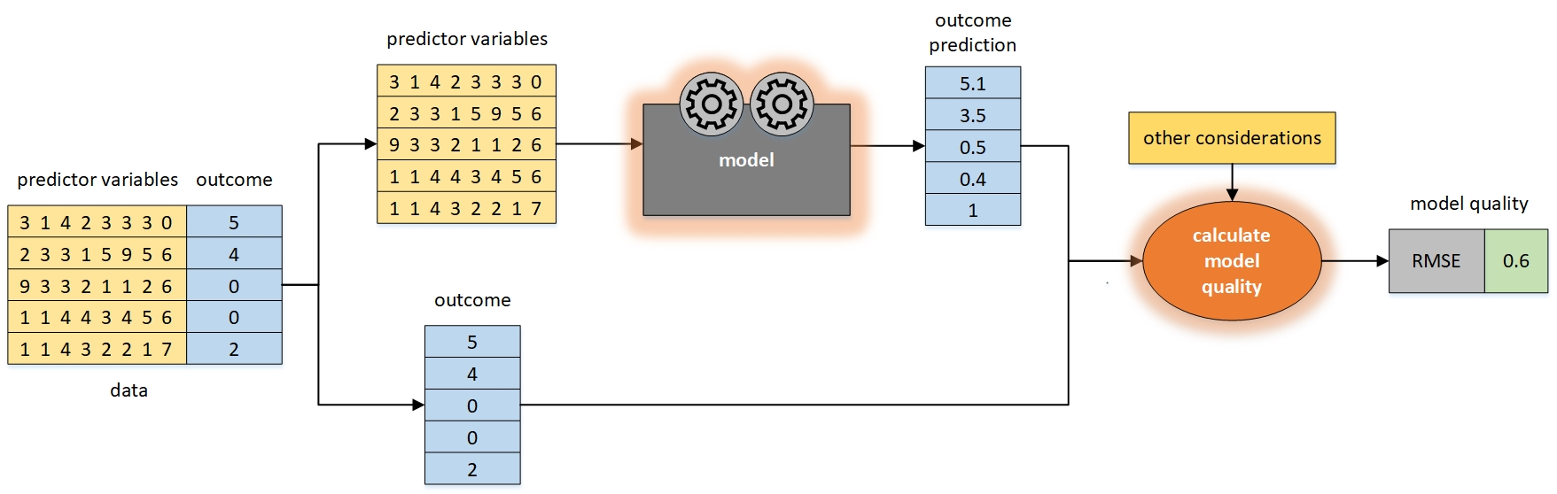
Regression
Evaluate

Slide 11
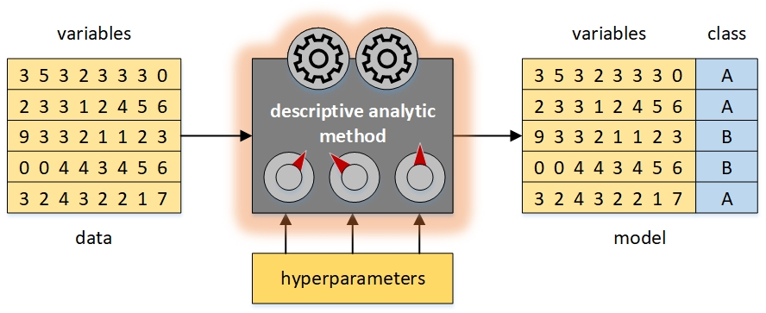
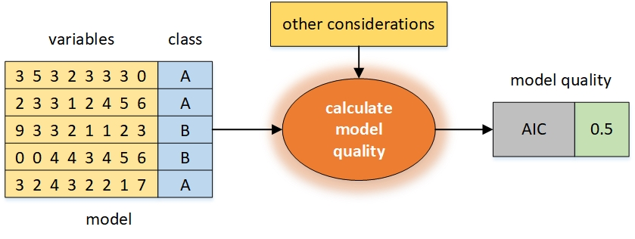
Cluster Analysis
Train
Evaluate

Slide 12
Model Optimization
Search for best data analytic method (type of model)
Search for best data
Search for best representation of data
Search for best variables
Search for best hyperparameter values

Slide 13
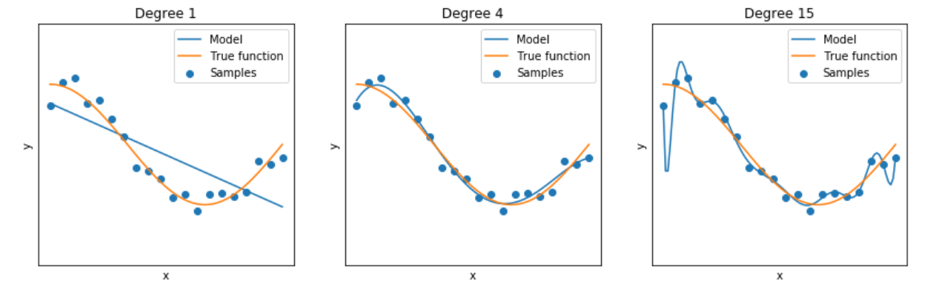
Bias/Variance Tradeoff
variance↓ bias↑ ➔ underfit
variance↑ bias↓ ➔ overfit

Slide 14
Tutorial
Week 1 Tutorial
Review how to use Jupyter, Python, matplotlib
Introduction to sklearn

